Slide 1
The meb-poc manufacturing system
Team Tfls:
Tiziano Santilli
Fabio di Silvestro
Leonardo Marrancone
Sahil babel
Università degli Studi dell’Aquila – Software Architectures – Academic Year 2018/2019

Slide 2
Domain and problem that we are solving
We have several tools that send messages (160.000 every 30 minutes).
These messages needs to be stored in a database and shown in a dashboard.
We have to manage the path of the messages from the tools to the database and the dashboard.

Slide 3
Functional requirements
The system has to manage events intercepted from tools.
The system has to compute these events and gets additional information from the raw_data database.
The system has to provide a user-friendly dashboard.
The system has to store the computed data for querying.
The dashboard needs to provide a complete system of filtering.

Slide 4
Non functional requirements
The system must be without a single point of failure.
The system must manage peaks of 160000 messages every 30 minutes and must scale.
The system must be up 99.999%.
The system needs to take no more than 5 minutes from the time the message is broadcasted from the tool to the time it is stored in the analytics database. However, the lower the delay the better.

Slide 5
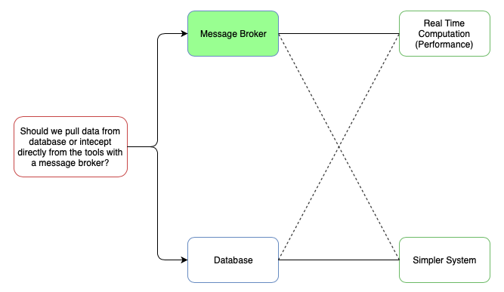
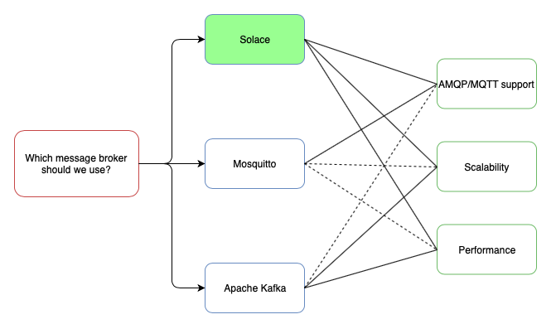
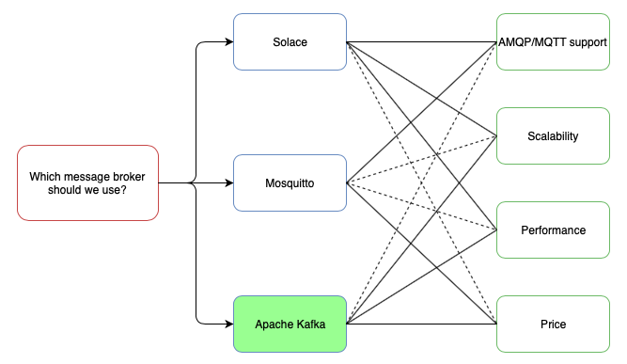
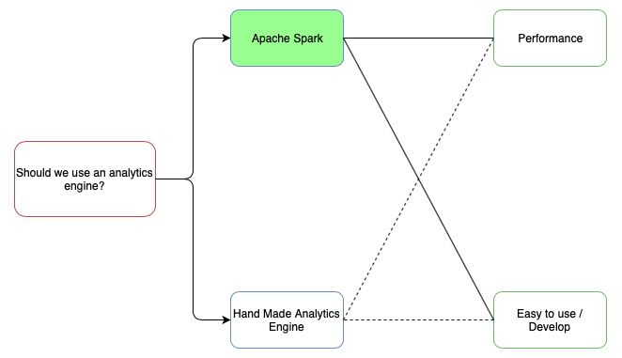
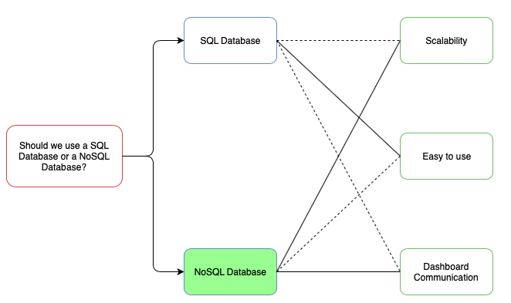
Design Decisions
Università degli Studi dell’Aquila – Software Architectures – Academic Year 2018/2019

Slide 6




TECHNOLOGIES
In our project we used four main technologies:
Solace as message broker with MQTT IoT protocol
Apache Spark as analytic engine
Elasticsearch as NoSQL database
Kibana as dashboard
Università degli Studi dell’Aquila – Software Architectures – Academic Year 2018/2019

Slide 7

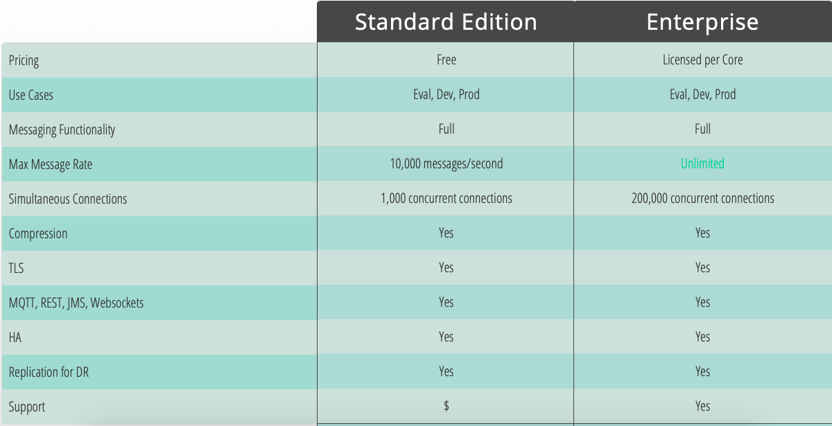
Design Decisions 1/3
We used Solace because is one of the fastest message broker, is fault tolerant, supports IoT protocols. Solace is not free, but the basic plan is free and is more then enough for the project specification.
Options rejected:
Apache Kafka because it doesn’t support IoT message protocol.
Mosquito because can’t scale properly.
Università degli Studi dell’Aquila – Software Architectures – Academic Year 2018/2019

Slide 8
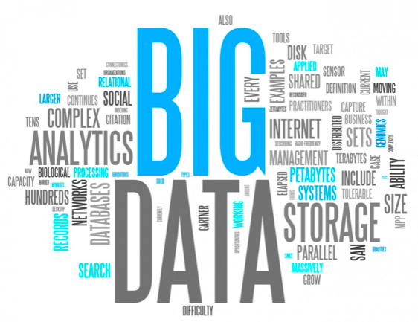
Design Decisions 2/3
We used Apache Spark as analytic engine because is really fast, fault tolerant, it was built to manage Big Data and is highly scalable.
Options rejected:
Handmade analytic engine because we can’t proof performance with Big Data and we can’t reach the reliability of Apache Spark.
Università degli Studi dell’Aquila – Software Architectures – Academic Year 2018/2019

Slide 9

Design Decisions 3/3
Elasticsearch and Kibana: we used these technologies because they are fault tolerant and they are extremely fast for searching the data and Kibana has a great filtering system.
Options rejected:
SQL Database because is not too much scalable and is slower for inserting data and for query search.
Università degli Studi dell’Aquila – Software Architectures – Academic Year 2018/2019

Slide 10
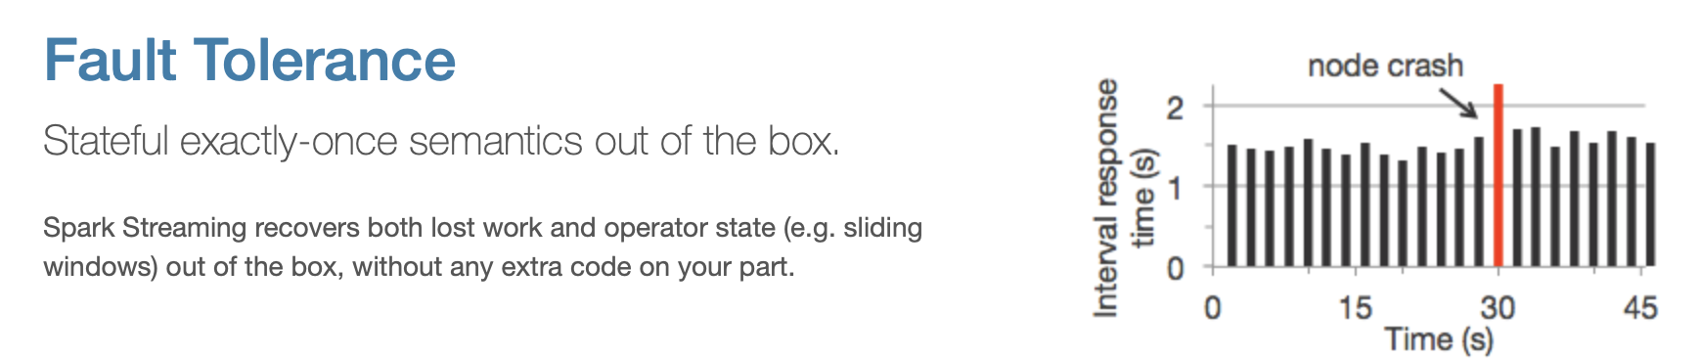
fault tolerance
Solace is one of the most reliable message broker.
Apache spark
Elasticsearch is based on a cluster architecture, this consent to use multiple nodes. A node can be a copy (replica) or can be “shards”, it means that we can distribute the system.
Università degli Studi dell’Aquila – Software Architectures – Academic Year 2018/2019

Slide 11
costs
Solace has a free basic plan that is enough for our specification. Is not free if you exceed 10000 messages/second or 1000 simultaneous connections.
Apache Spark is completely free and open source.
Elasticsearch and Kibana are completely free and open source.
Università degli Studi dell’Aquila – Software Architectures – Academic Year 2018/2019

Slide 12
scalability
With solace the scalability is not a problem, because a single node can manage over 200000 messages per second.
Apache spark is born to manage Big Data and is scalable.
Elasticsearch lies on the concept of scalability because you can easily create as much node as you need.
Università degli Studi dell’Aquila – Software Architectures – Academic Year 2018/2019

Slide 13
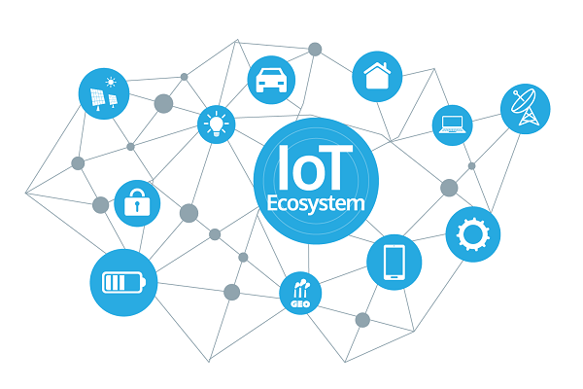
Iot protocols support
Our prototype is IoT ready, because we use the MQTT message protocol and all the technology that we used are ready to manage IoT data.
Università degli Studi dell’Aquila – Software Architectures – Academic Year 2018/2019

Slide 14
Architectural pattern 1/2
Our architectural patter is an hybrid: Publish/Subscribe + Layered
Layered because our system can be divided into four layer: Message Broker, Processor, Storage and Dashboard.
Publish/Subscribe the first layer is based on a pure P/S Architecture.
Università degli Studi dell’Aquila – Software Architectures – Academic Year 2018/2019

Slide 15
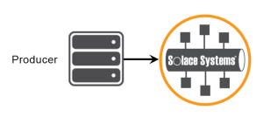
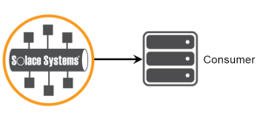
Architectural pattern 2/2
Dashboard
Storage
Layered
Processor
Message broker
P/S
Università degli Studi dell’Aquila – Software Architectures – Academic Year 2018/2019

Slide 16
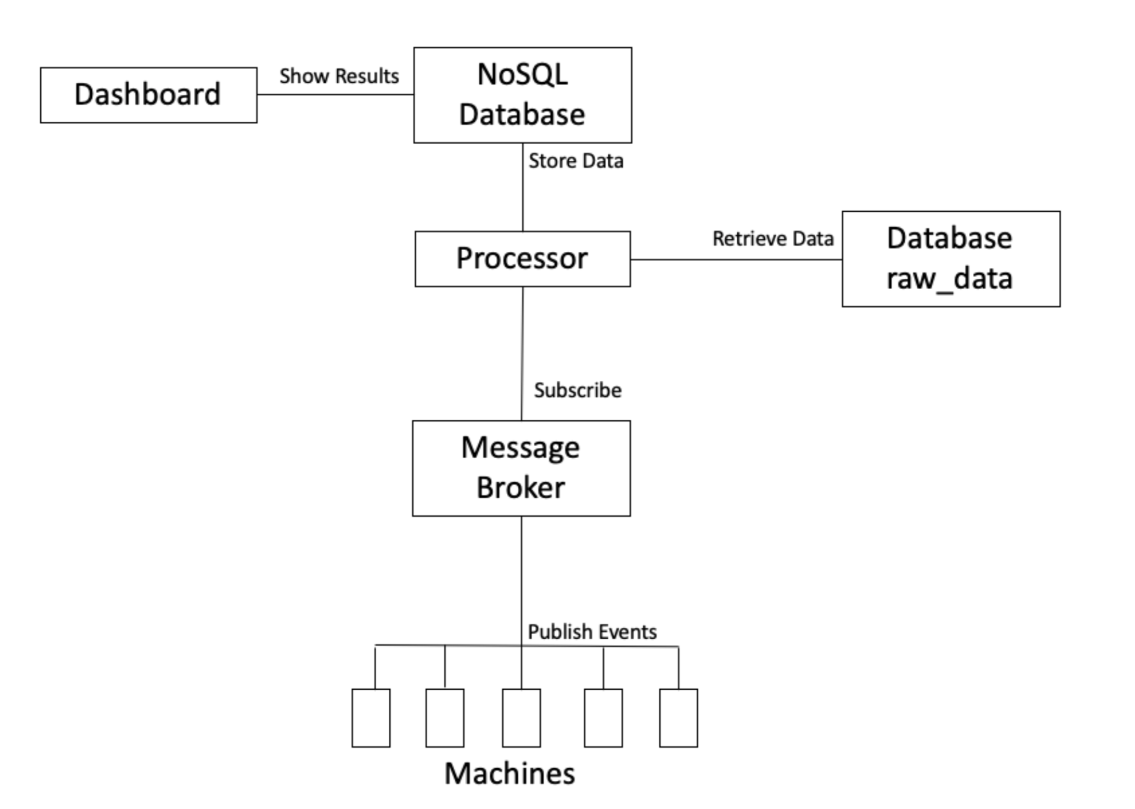
Informal System description
Kibana and Elasticsearch
External part simulated by
an SQL DB that we created
Apache Spark
Solace message Broker
External part simulated by an
XML event creator that we made.
Università degli Studi dell’Aquila – Software Architectures – Academic Year 2018/2019

Slide 17
Focus on requirements
The baseline of our project was to reach all the requirement in the best way.
When we were developing the prototype, always kept in mind two important concepts:
Verification: Are we building the product right?
Validation: Are we building the right product?
Università degli Studi dell’Aquila – Software Architectures – Academic Year 2018/2019

Slide 18

Functional requirements 1/2
The system has to manage events intercepted from tools.
The events are collected via Solace and managed using Apache Spark.
The system has to compute these events and gets additional information from the raw_data database.
Our system computes the events and gets additional information from raw_data using Apache Spark.
The system has to provide a user-friendly dashboard.
Our system integrates Kibana that provide a GUI for visualizing and querying. The dashboard is reachable within the LAN through a web browser.
Università degli Studi dell’Aquila – Software Architectures – Academic Year 2018/2019

Slide 19
Functional requirements 2/2
The system has to store the computed data for querying.
Our system stores the data in Elasticsearch NoSQL database.
The dashboard needs to provide a complete system of filtering.
With Kibana the end-user can set all the filter that needs through the GUI. We saved a bunch of filters ready to use.
Università degli Studi dell’Aquila – Software Architectures – Academic Year 2018/2019

Slide 20
Non-Functional requirements 1/2
The system must be without a single point of failure.
All the technologies that we used are without point of failure. Solace, Elasticsearch and Spark lie on the concept of Clusters and Nodes. It means that there are distributed nodes and replicas.
The system must manage peaks of 160000 messages every 30 minutes and must scale.
Our System can manage approximately 216000 messages every 30 minutes in almost real time (<2.5sec) and both Elasticsearch and Spark are scalable on multiple nodes.
Università degli Studi dell’Aquila – Software Architectures – Academic Year 2018/2019

Slide 21
Non-Functional requirements 2/2
The system must be up 99.999%.
We can’t prove mathematically that our system can reach the three 9, but we tested with about 1 million messages without errors, so we think that we achieved the target.
The system needs to take no more than 5 minutes from the time the message is broadcasted from the tool to the time it is stored in the analytics database. However, the lower the delay the better.
Our system takes at most 1.5 seconds from the time the message is broadcasted from the tools to the time it is stored in the Elasticsearch database, we have to add another second to make the data searchable from the Kibana dashboard.
Università degli Studi dell’Aquila – Software Architectures – Academic Year 2018/2019

Slide 22


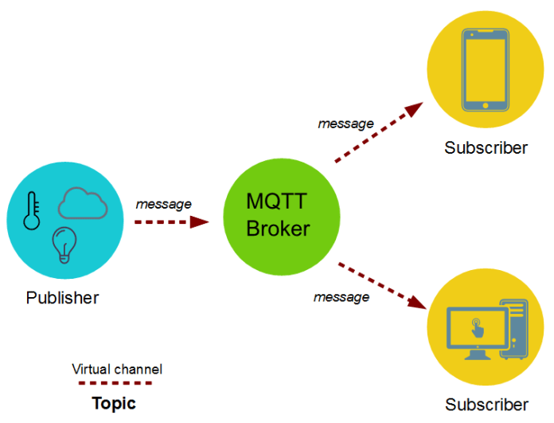
Interface
Our system is IoT ready, that mean that we offer an MQTT interface where all the devices (or tools in this domain) can publish on the message broker using this message protocol.

Slide 23
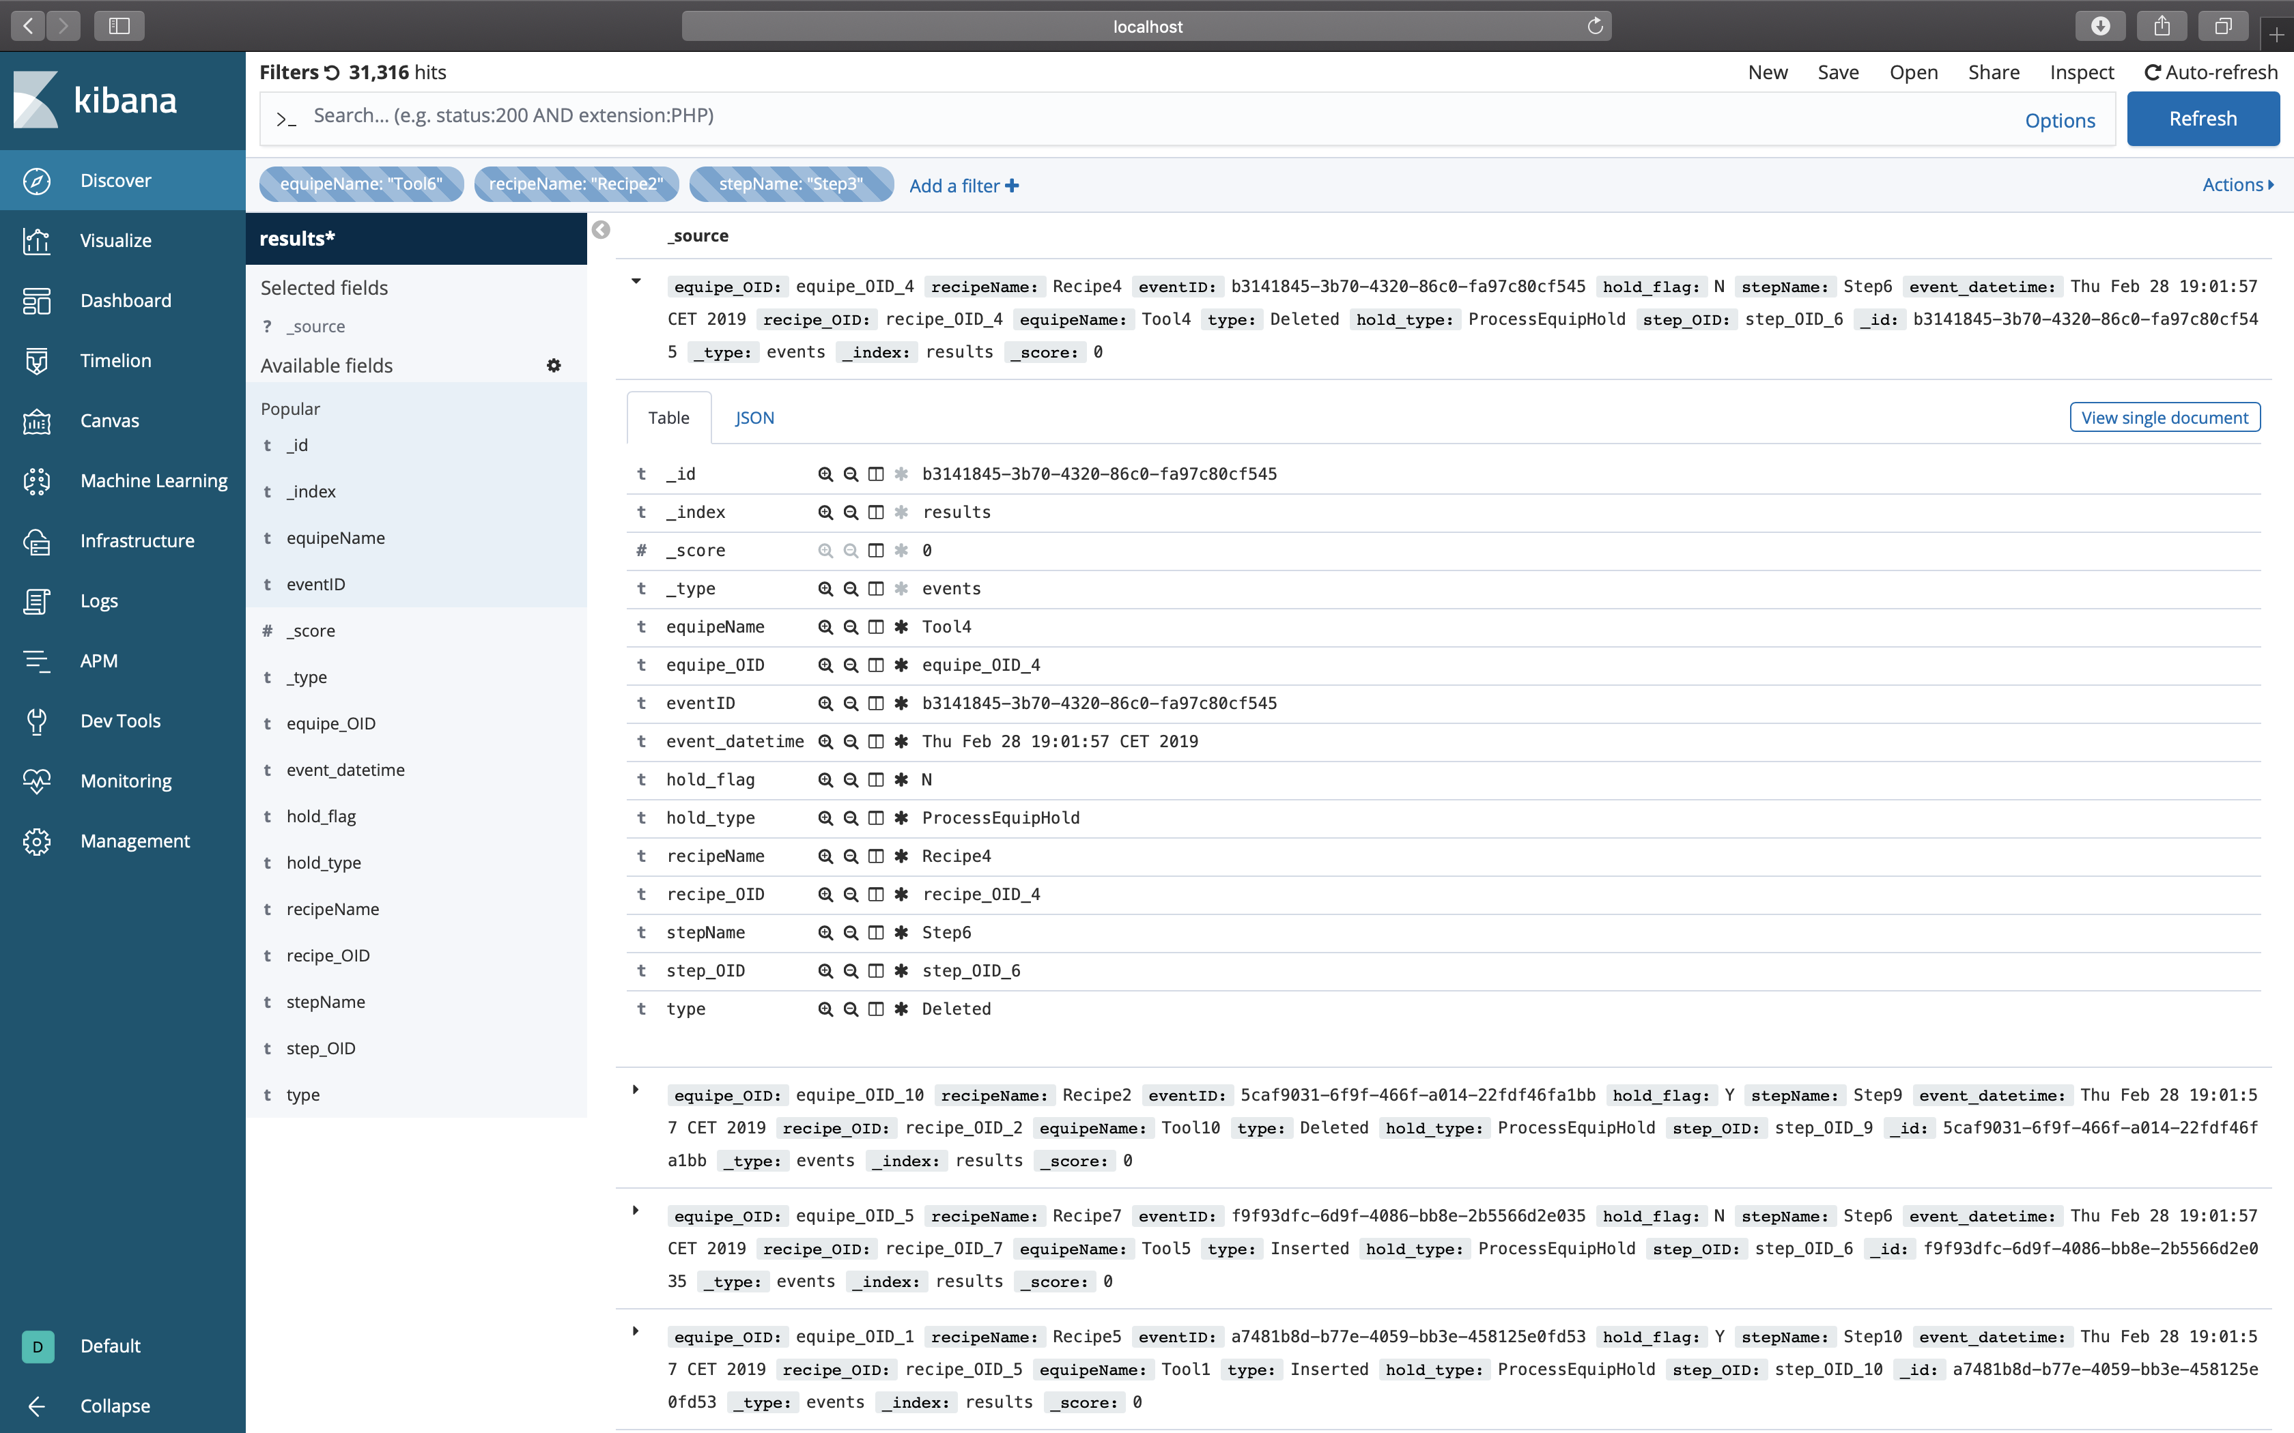
Advanced Custom
Filtering System
Complete Data
Visualization
Compact Data
Visualization
Quick Filtering System

Slide 24
Thank you for your attention.
The system has been developed on the following machines:
Solace: Virtual Box VM, 2 Virtual CPU, 8 GB Ram
Elasticsearch, Kibana, Spark: MacOS, Intel i7, 16 GB Ram
Tools: MacOS, Intel i5, 4GB Ram
Implementation technologies:
Java 1.8
Maven
Eclipse Paho
Spark APIs
Elasticsearch APIs
Università degli Studi dell’Aquila – Software Architectures – Academic Year 2018/2019

